Slide 1

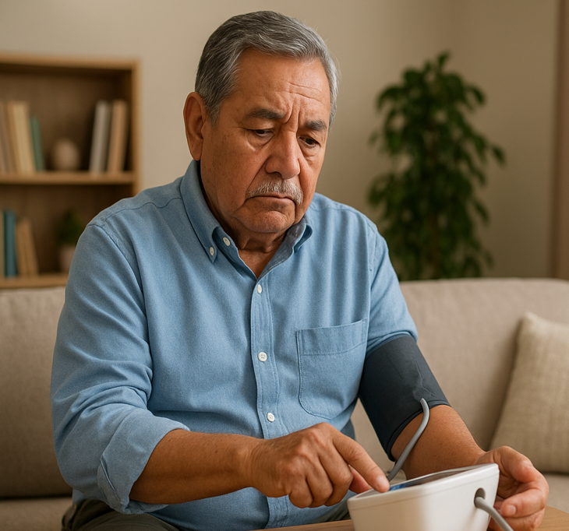
Remote Patient Monitoring addresses common barriers to in-person care among Hispanic seniors. Many face transportation issues, long waits, or rural isolation. A national analysis found over 21 % of adults lacking vehicle or transit access skipped needed care due to transportation problems, disproportionately affecting Hispanic adults.
These obstacles are worse in rural areas where seniors may no longer drive and public transit is limited. Structural inequality further magnifies disparities: Hispanic seniors often live in underserved areas with scarce providers, causing delays and poorer outcomes. By leveraging remote patient monitoring, clinics can deliver care virtually, reducing travel burdens and increasing continuity. Thus, institutions mitigate physical and system level barriers effectively.
RPM: Managing Chronic Conditions Proactively
Chronic illnesses like hypertension, diabetes, cardiovascular disease are prevalent among Hispanic older adults and require consistent monitoring.
This enables daily or weekly remote tracking of blood pressure, glucose, and symptoms. A large study links RPM integration in clinical workflows with significantly improved blood pressure control over time.
Moreover, RPM programs show sustained HbA1c reductions at six and twelve months across diverse populations.
In a study of a Federally Qualified Health Center cohort, 89% were Hispanic/Latino and uninsured, and they used Remote Patient self measured blood pressure monitoring an average of 72 times over 120 days, indicating high engagement. These findings demonstrate RPM’s ability to maintain proactive chronic disease oversight when clinic visits fall short.
eHealth anytime, anywhere

Slide 2

Enhancing Outcomes & Satisfaction
RPM not only improves clinical results but also enhances patient satisfaction and reduces costs.
A COVID-19 RPM program at Mayo Clinic showed markedly lower 30 day mortality (0.5% vs 1.7%) and cost savings of $1 259 per patient, mostly from avoided hospital stays.
Another aggregate analysis of over 40.000 patients in a combined RPM and chronic care management program reported significant improvements in hypertension, diabetes, and obesity outcomes.
These programs support value-based care by reducing avoidable admissions and improving metrics critical for performance based reimbursements. Remote modalities elevate satisfaction too, as patients appreciate easier access and proactive follow up.
Why Esvyda is the Best Choice
Esvyda stands out as the ideal solution for institutions serving Hispanic seniors. Our bilingual, secure, and compliant platform ensures seamless communication and regulatory adherence.It supports improved clinical outcomes like reduced A1c levels and better blood pressure control through regular monitoring and provider alerts. Our system boosts patient satisfaction by eliminating travel burdens and enabling personalized support.
Moreover, Esvyda drives metrics in value-based programs: fewer hospital admissions, better chronic disease indicators, and optimized cost of care. Its coordination features ensure effective care team collaboration across settings. In sum, Esvyda delivers culturally competent, outcome driven, and satisfaction focused RPM tailored for Hispanic older adults.
eHealth anytime, anywhere

Slide 3
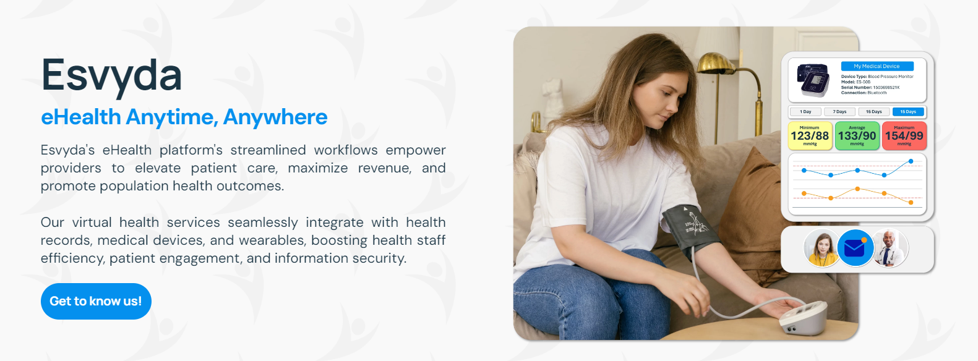
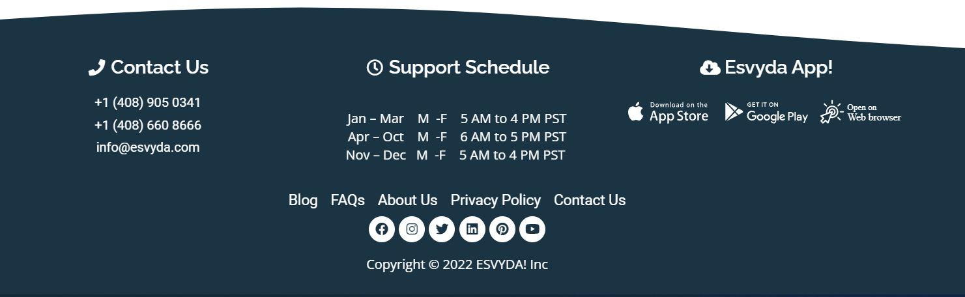
Get to know us!
www.esvyda.com
eHealth anytime, anywhere
eHealth anytime, anywhere

